Slide 1
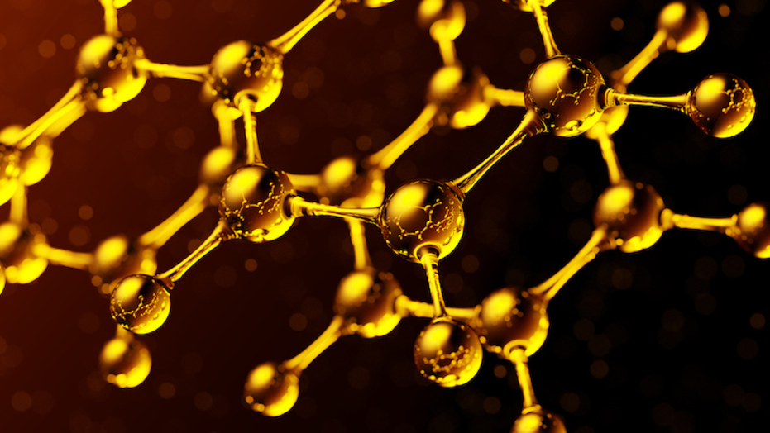
Aromatics
Naming, Properties, isomers and reactivity

Slide 2
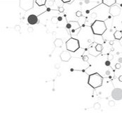
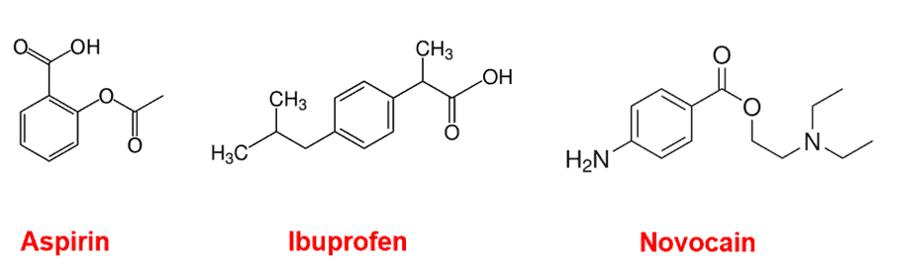
Aromatic – introduction
The name is derived from nice smelling oils
The only one you need to know is benzene, C₆H₆
A number of nice smelling natural products contain aromatic compounds
A number of medicinal compounds are also benzene derivatives

Slide 3
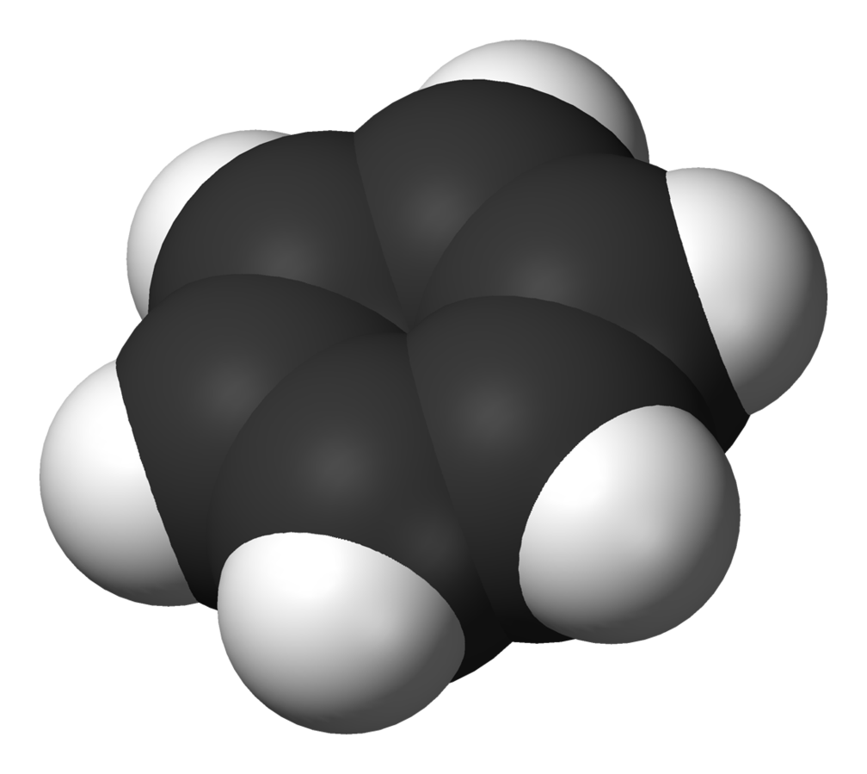
Aromatic – structure
Space filling model of benzene
A flat, hexagonal ring
One hydrogen per carbon
Crystal structure shows that all of the C-C bonds in benzene are 140 pm (picometers).
A single bond is typically 137 pm and a double bond is 147 pm. So what is a C-C bond in benzene? Single, double or something else?

Slide 4
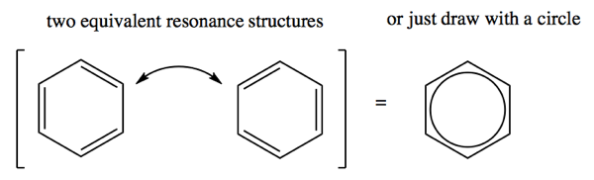
Aromatic – structure
The intermediate bond length is consistent with delocalised electrons
Each carbon forms 3 singles bonds, the fourth valence electron is delocalised around the carbon ring.
So, how do we draw the structure of benzene given our line system only has single, double and triple bonds? How do you draw a part bond?

Slide 5
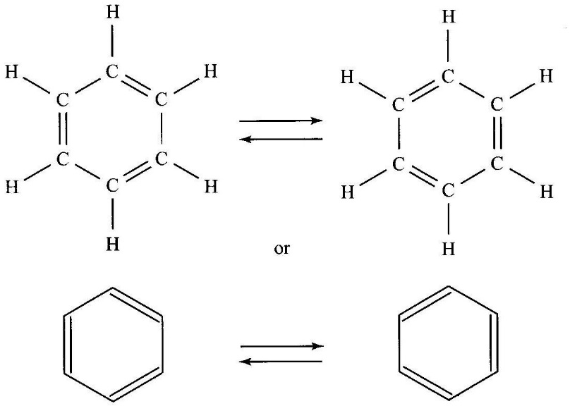
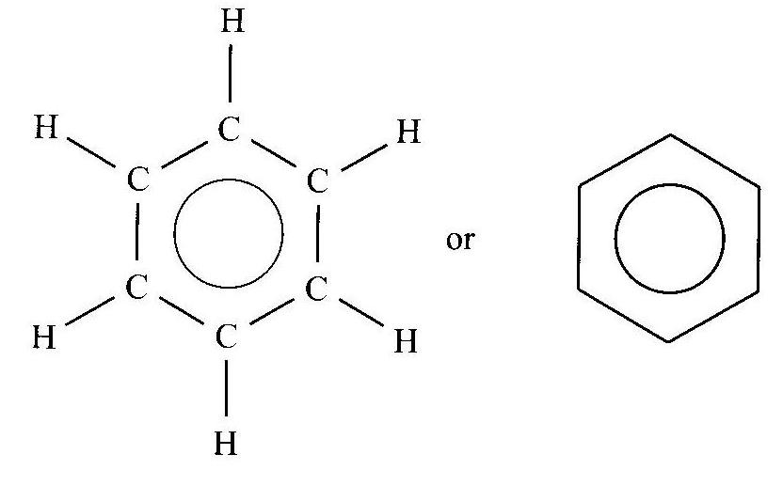
Aromatic – structure
Bonding proposed by Kekulé: resonance between structure A & B
Current model: shared
delocalised electrons

Slide 6
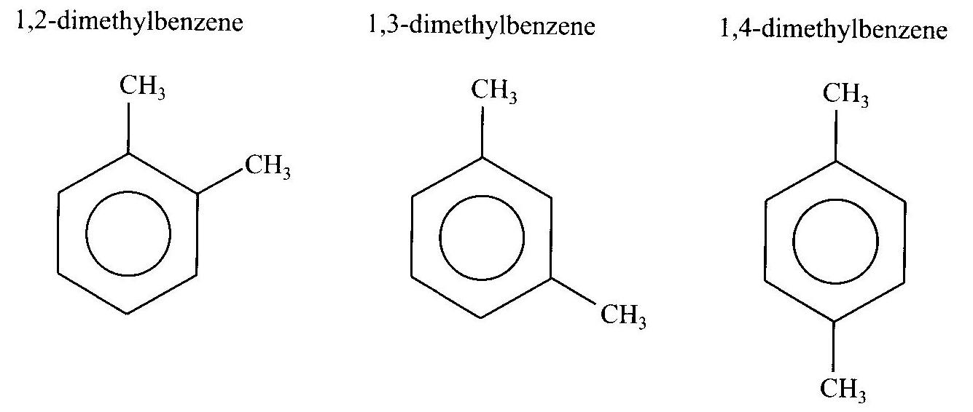
Aromatic – naming and isomers
Three position isomers of dimethylbenzene

Slide 7
Aromatic – reactivity
Benzene does not contain any double bonds and it is uniquely stable due to the delocalized electrons
Therefore, it can not undergo an Addition reaction the way alkenes can
Benzene does have single C-H bonds, so what reactions do you think will be possible?
Combustion reactions: produces water and carbon dioxide (or carbon monoxide)
Substitution reactions: substitute a hydrogen for a halogen

Slide 8

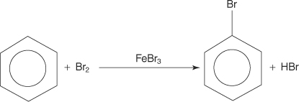
Aromatic – reactivity
Combustion reactions: this is the complete combustion, but you should be able to write the incomplete reaction as well.
Substitution reactions: benzene plus halogen in presence of a catalyst (remember substitution reactions are very slow)

Slide 9
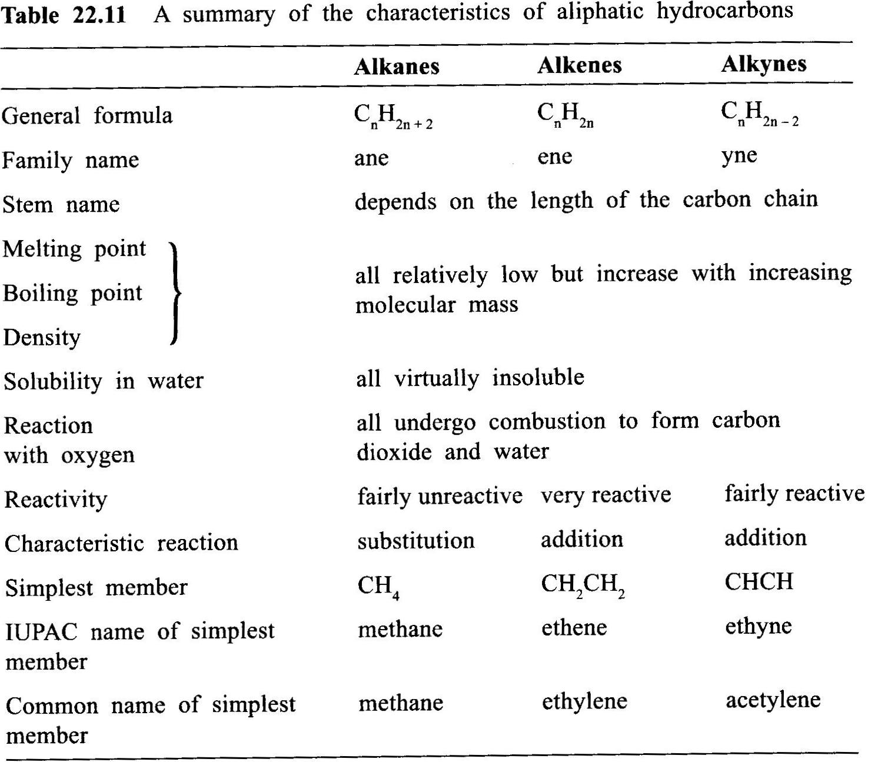
Summary of alkane, alkene and alkynes

Slide 10
On going work
Pearson chapter 8.2
If you need more practice you can do STAWA sets 40 and 41

